Slide 1


Energy Optimization For Building(Labs) Guided By:- Dr. Balwinder Sodhi
Ashish Kohli ( 2023CSM1002 ) ( Focused on Hardware Part & Database Part
Nayan Sawarkar ( 2023AIM1007 ) ( Focused on Web Development
Related part )
Presented By :-

Slide 2
Project Overview
Introduction
The primary goal of this project is to develop an intelligent web-based platform designed to
monitor, analyze power consumption across various departments and laboratories within an
organization. The platform will provide real-time insights into energy usage , identify
inefficiencies of power consumption and offer users personalized, data-driven
recommendations to enhance energy efficiency and reduce costs.

Slide 3
Project Objective
Focus on using efficient energy and avoiding waste.
Provide easy-to-understand data that helps make better decisions.
Implement Real-Time Monitoring.
Provide recommendations to users on where power is being lost.
Ensure security and authentication to protect data and system access.

Slide 4
Hardware:-

Slide 5
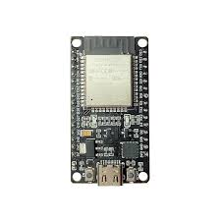
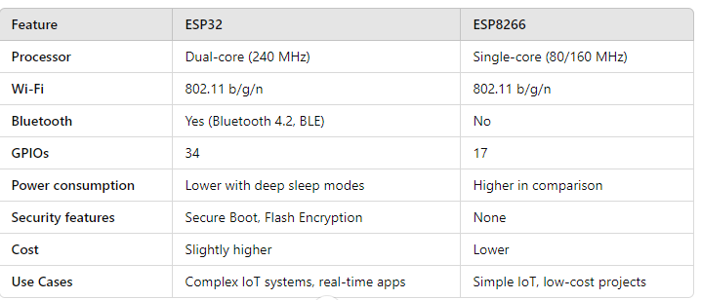
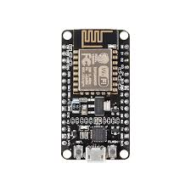
Task 1) Select Microcontroller to share sensor data .
ESP8266 Connect
with sensor
ESP32 Centralized
Microcontroller

Slide 6
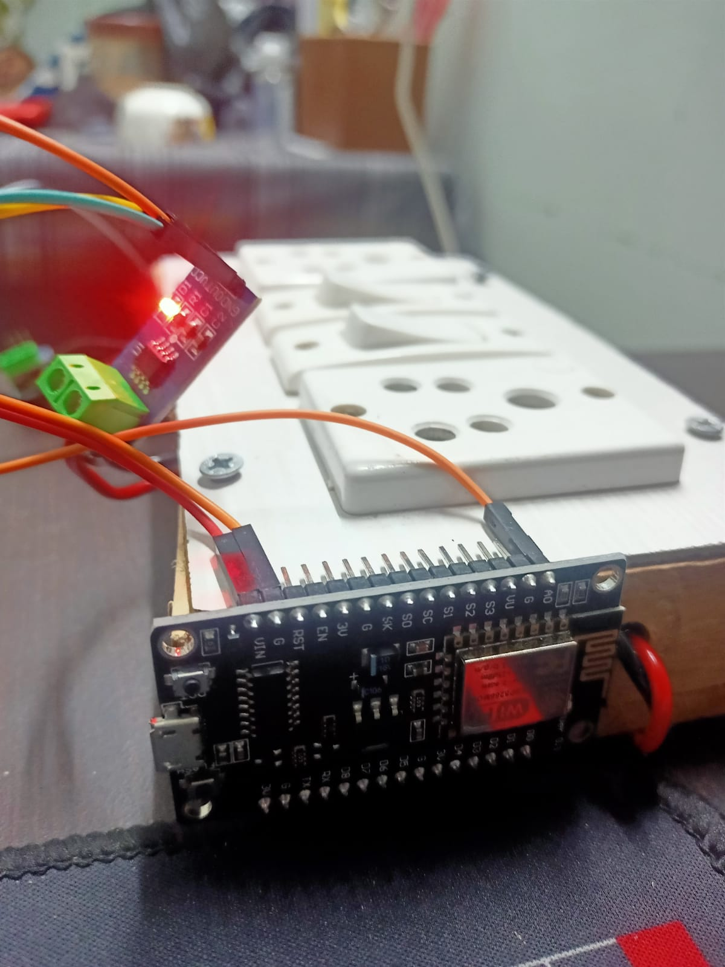
Task 2) How to Calculate the Power consumption of a Device.
ACS712 Sensor measure a current of each device.
Microcontroller(Esp32) send a data to central microcontroller

Slide 7
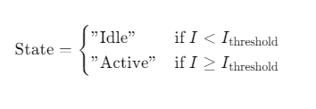
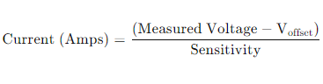
Task 3) How to Detect Machines is Idle Mode
Sensor:- ACS712 current sensor
Microcontroller:- Esp32
Set Threshold for a Device if current is less than threshold means its in idle state

Slide 8
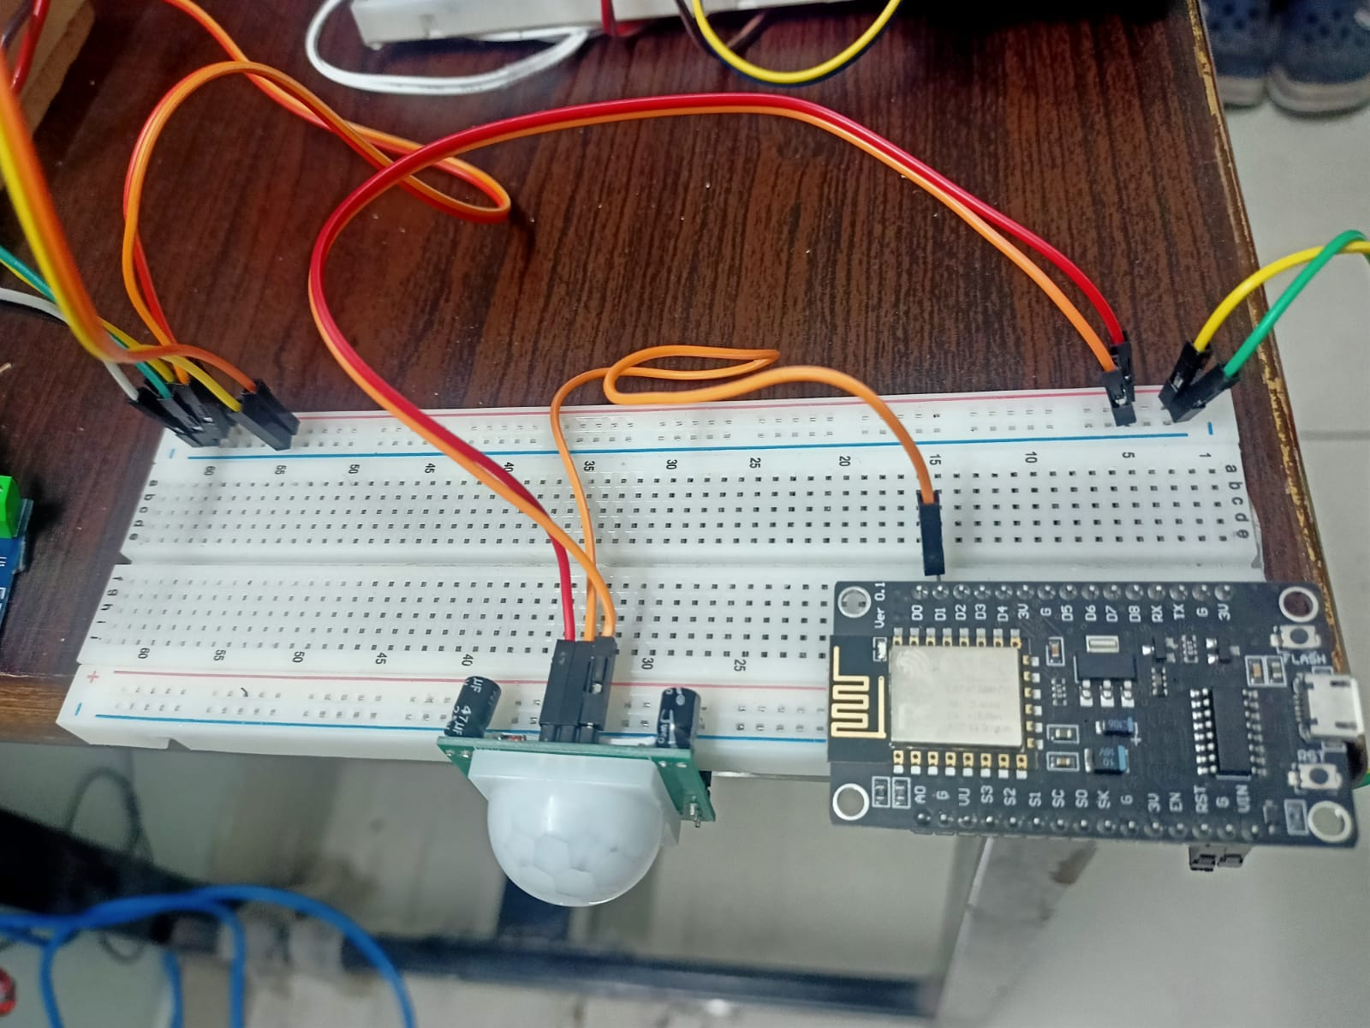
Task 4) How To Detect Human Presence in a Room:
Microcontroller(Esp8266) send a data to central microcontroller
PIR sensor to detect Human Presence in a room .

Slide 9
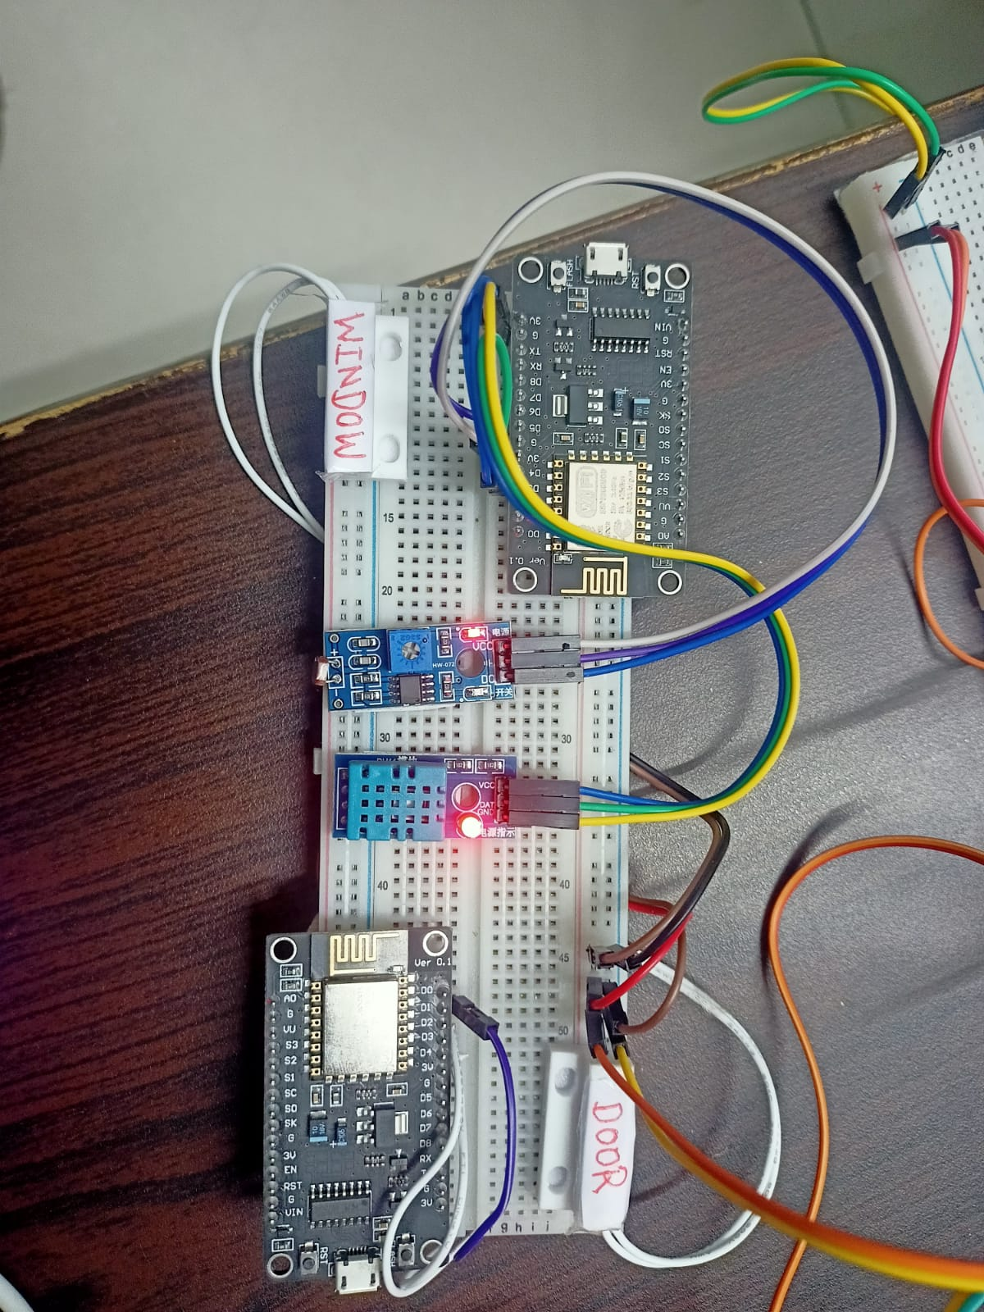
Task 5) Monitor environmental conditions like temperature and light intensity.
Microcontroller(Esp8266) send a data to central microcontroller
LDR sensor to detect Light intensity in a room
DHT11 Sensor to measure room temperature and humidity

Slide 10
Task 6) How To Detect Doors and Windows Are open
Microcontroller(Esp8266) send a data to central microcontroller
Window sensor
Door Sensor

Slide 11
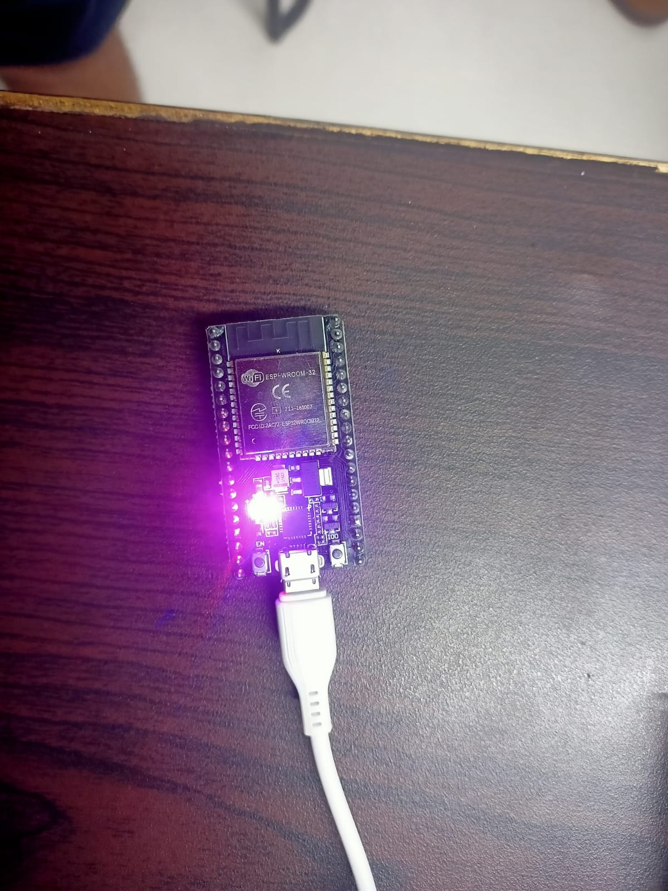
Centralized Microcontroller
Centralized Microcontroller: The centralized microcontroller (ESP32) acts as a hub, managing data flow between connected devices and the server.
Data Transmission to Server via HTTP: The microcontroller sends collected data to the server using the HTTP protocol for centralized monitoring and analysis.
Data Reception via ESP-NOW: The microcontroller receives data from other microcontrollers (sensors) using the ESP-NOW protocol for efficient and low-power communication.
Periodic Operation Cycle: The system operates in a hybrid mode, alternating between sending data to the server via HTTP and receiving data from sensors via ESP-NOW.

Slide 12
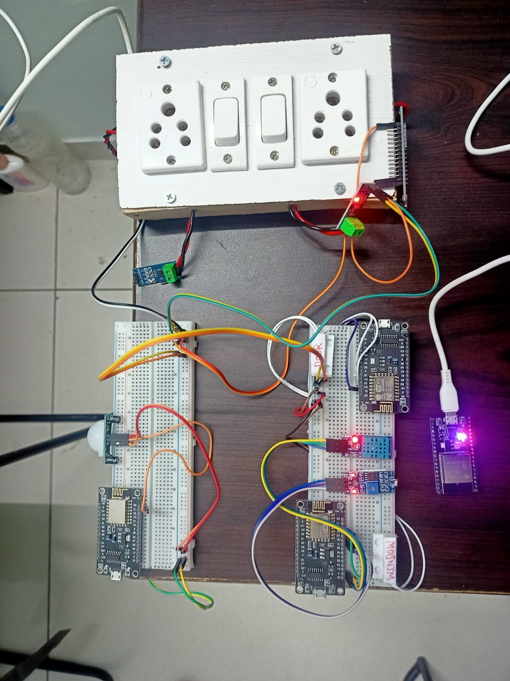
Hardware Setup
Its is a connection of wireless sensor network.
Each sensor connect with microcontroller by a wired.
Each microcontroller(sensor) send a data to centralized microcontroller.
Each microcontroller connect with centralized microcontroller by a wireless.
ESPNOW protocol is used to connect each microcontroller to centralized microcontroller.

Slide 13
Communication And Connectivity :-

Slide 14
Hybrid Method (ESP-NOW + HTTP)
In our project, we use a hybrid method where we combine the benefits of both ESP-NOW and HTTP:
Peer-to-Peer Communication with ESP-NOW:
ESP-NOW enables local communication between devices (sensors) without requiring a router or internet. This allows devices like PIR sensors, temperature sensors, and door/window sensors to communicate directly with a centralized ESP32 in a low-power, fast, and secure manner.
Client-Server Communication with HTTP:
The centralized ESP32 acts as a client and uses HTTP to send aggregated data to a remote server. This allows the server to store, process, and visualize the data, making it available for remote monitoring and management.

Slide 15
Benefits of the Hybrid Method
Efficiency: ESP-NOW ensures low-power consumption and real-time communication between devices, while HTTP handles data storage and visualization on the server side.
No Need for a Router: ESP-NOW eliminates the need for routers for device-to-device communication, simplifying the setup.
Scalability: HTTP enables easy scaling to support more devices and handle large datasets on the server .
Secure and Reliable: AES-128 encryption in ESP-NOW ensures secure local communication, while HTTP ensures secure data transfer using HTTPS or TLS for encryption.

Slide 16
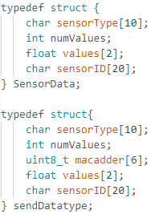
Packet send by each Sensor to Centralized microcontroller
Packet send by Centralized Microcontroller to Server

Slide 17
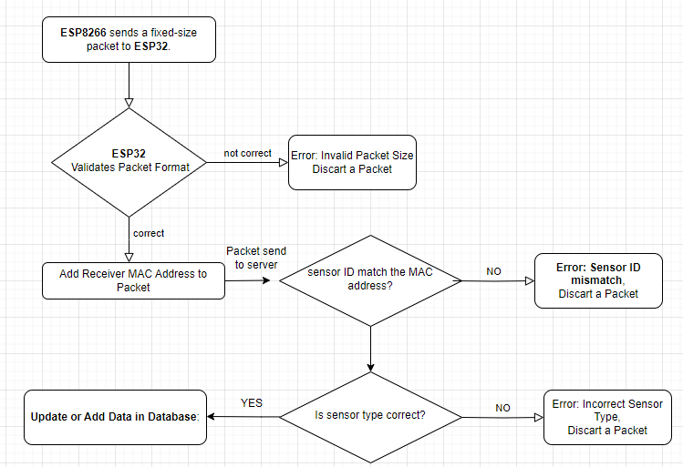
DATA FLOW:-

Slide 18
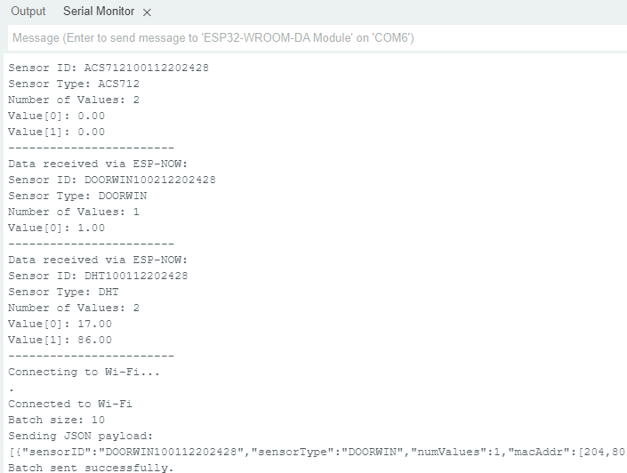
Received Data
Send Data
Send data in using batch processing

Slide 19
THANK YOU
06/01/2025
CSE conference room
ASHISH KOHLI 2023CSM1002

